Slide 1

Data Structures
Lecture 2: Efficiency of Algorithms

Slide 2

What is Efficiency?
The use of as few resources as possible to accomplish a goal.
Algorithm efficiency is measured in terms of its performance (time) and memory usage (space).
The less the time an algorithm takes and the less memory it requires, the better its efficiency.

Slide 3
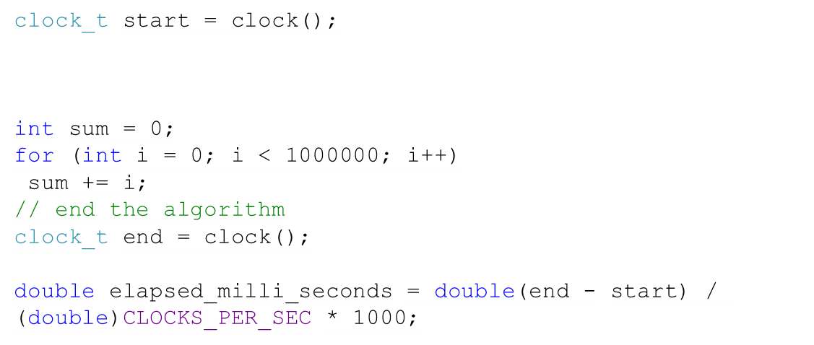
How Can We Measure Algorithm Performance?
We can measure the time using the CPU clock. Programming languages allow measuring the time.
What is the problem with this solution?
The time depends on many factors:
CPU properties
Programming Language
Compiler
Quality of the Algorithm
We want to compare the quality of the algorithm regardless of the CPU, programming language, compiler, etc.
Not in the book

Slide 4
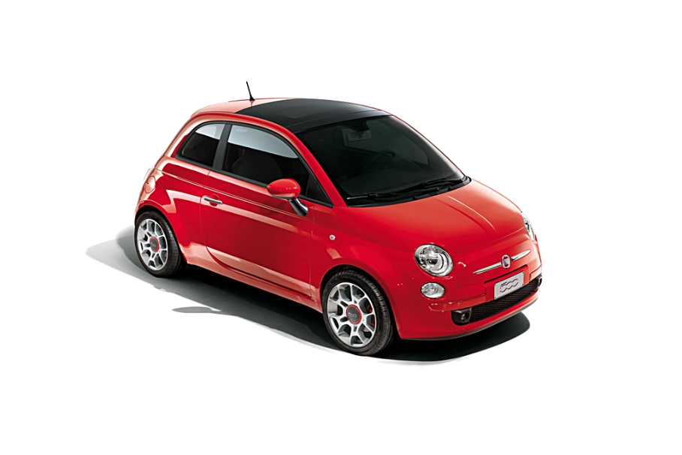

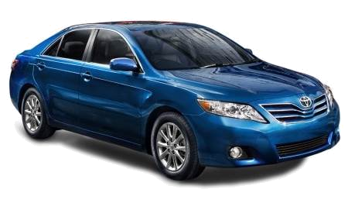
Big-O Notation (1)
Not in the book
Automobiles can be classified by size regardless of the actual dimensions:
subcompact
Midsize
Large

Slide 5
Big-O Notation (2)
Not in the book
Can we also compare (or classify) the algorithms in terms of performance regardless of their actual performance? Yes!
Using the Big-O (Order of magnitude) notation. It also allows us to compare the performance of algorithms regardless of the CPU, programming language, compiler, etc.
Big-O allows you to analyze the performance of an algorithm based on the size of the input (usually symbolized by n )

Slide 6

Example A
How many times will the statement be executed?
for(int j=0; j<4; j++) {
Simple statement
}
The statement will be executed when j=0, j=1, j=2, j=3
The statement will be executed 4 times
for(int j=0; j<n; j++) {
Simple statement
}
The statement will be executed n times
T(n) = n , T(n) is the time a function or a program takes as a function of the number of inputs

Slide 7
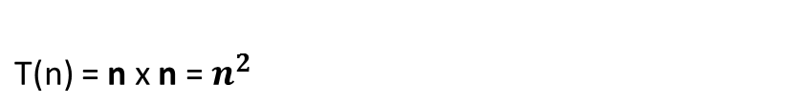
Example B
for(int i=0; i<3; i++) {
for(int j=0; j<4; j++) {
Simple statement
}
}
for(int i=0; i<n; i++) {
for(int j=0; j<n; j++) {
Simple statement
}
}
The statement will be run when i=0 and j=0,1,2,3
i=1 and j=0,1,2,3
i=2 and j=0,1,2,3
The statement will be executed 3 x 4 = 12 times

Slide 8
Example C (1)
for(int i=0; i<n-1; i++) {
for(int j=i+1; j<n; j++) {
1 Simple statement
}
}
T(n) =
n-1
+ n-2
+ n-3
for(int j=1; j<n; j++) {
1 Simple statement
}
When i=0, the statement runs for n-1 times
for(int j=2; j<n; j++) {
1 Simple statement
}
When i=1, the statement runs for n-2 times
for(int j=3; j<n; j++) {
1 Simple statement
}
When i=2, the statement runs for n-3 times

Slide 9
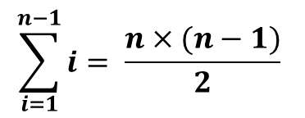
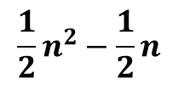
Example C (2)
for(int i=0; i<n-1; i++) {
for(int j=i+1; j<n; j++) {
1 Simple statement
}
}
T(n) =
n-1
+ n-2
+ n-3
+ …. + 2
+ 1
T(n) =
for(int j=n-2; j<n; j++) {
1 Simple statement
}
When i=n-3, the code runs for 2 times
for(int j=n-1; j<n; j++) {
1 Simple statement
}
When i=n-2, the code runs for 1 time

Slide 10


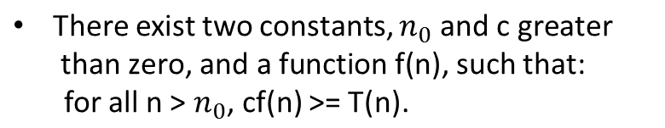

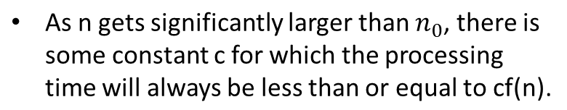

Example D (1)
for(int i=0; i<n; i++) {
for(int j=0; j<n; j++) {
Simple statement
}
}
for(int k=0; k<n; k++){
Simple statement 1
Simple statement 2
Simple statement 3
Simple statement 4
Simple statement 5
}
Simple Statement 6
Simple statement 7
. . .
Simple statement 30
+
+
25 times
The performance will never be worse than cf(n)

Slide 11
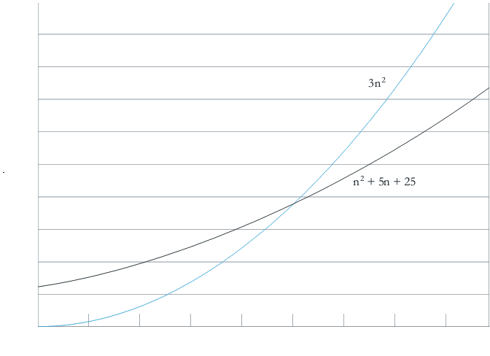



Example D (2)
We need to find a point where:
and solve for c, we get
of 5, this gives us a c of 3.
for all n greater than 5

Slide 12



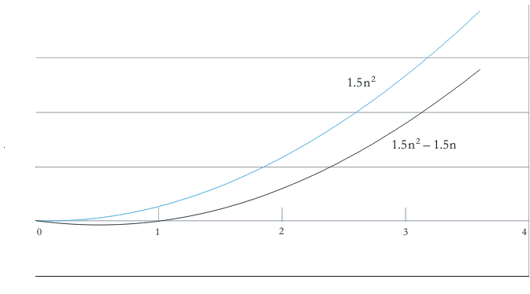


Example D (1)
T(n) = 3 x (n-1 + n-2 + .. + 2 + 1)
for(int i=0; i<n-1; i++) {
for(int j=i+1; j<n; j++) {
3 simple statements
}
}
T(n) = 0 when n = 1

Slide 13





Task (1)
Write T(n) and big-O expressions for the following loops.
for(int i=0; i<=n; i++)
for(int j=1; j<=n; j++)
for(int k=n; k>=1; k--) {
sum = i+j+k;
cout<< sum << endl;
}

Slide 14
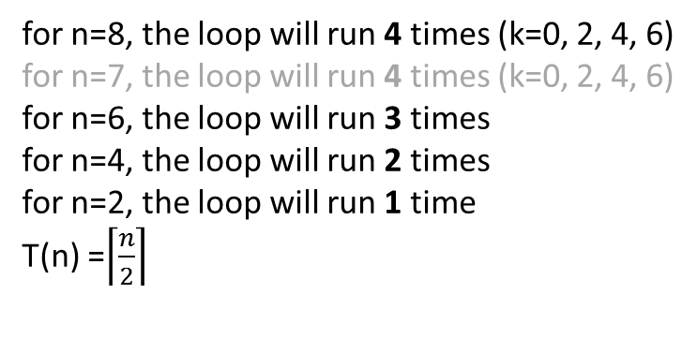
Task (2)
Write T(n) and big-O expressions for the following loops.
for( int k = 0; k < n; k += 2 ) {
//simple statement
}
O (n)

Slide 15
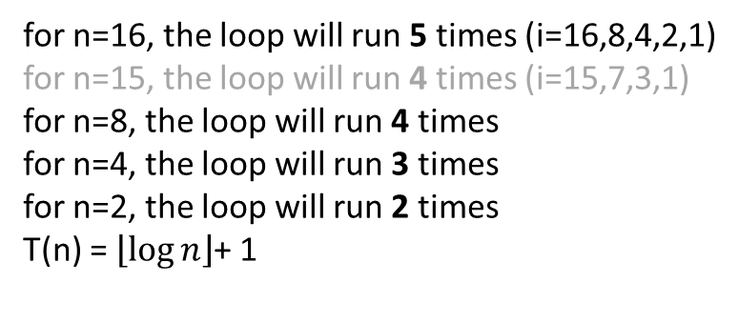
Task (3)
Write T(n) and big-O expressions for the following loops.
for(int i=n;i>0; i/=2)
cout<< i << endl;
O ( log n)

Slide 16
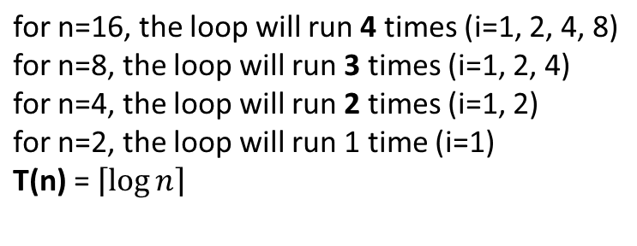
Task (4)
Write T(n) and big-O expressions for the following code
for( int i = 1; i < n; i *= 2 )
//Simple Statement
For n=15, the loop will run 4 times (i=1,2,4,8)
O ( log n)

Slide 17


Task (5)
Write T(n) and big-O expressions for the following code
log n
for( int i = n; i > 1; i /= 2 ) {
for( int j = 1; j < n; j *= 2 ) {
for( int k = 0; k < n; k += 2 ) {
// simple statement
}
}
}
log n
n/2

Slide 18
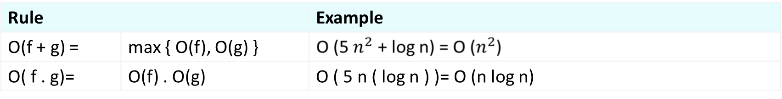
General Rules

Slide 19
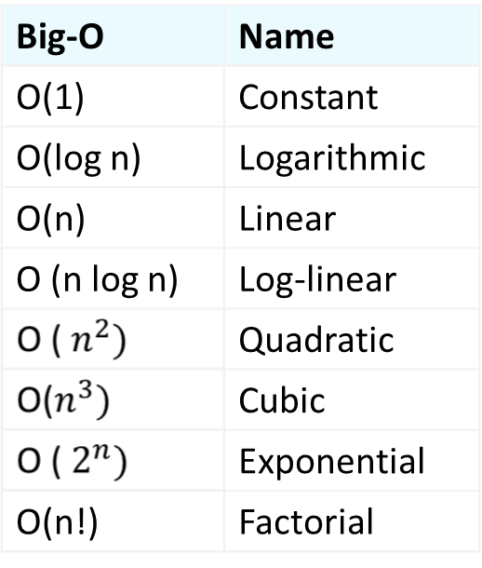
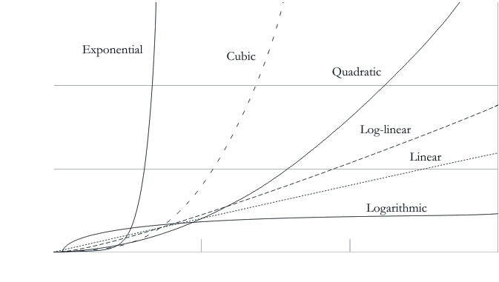
Comparing Performance (1)

Slide 20
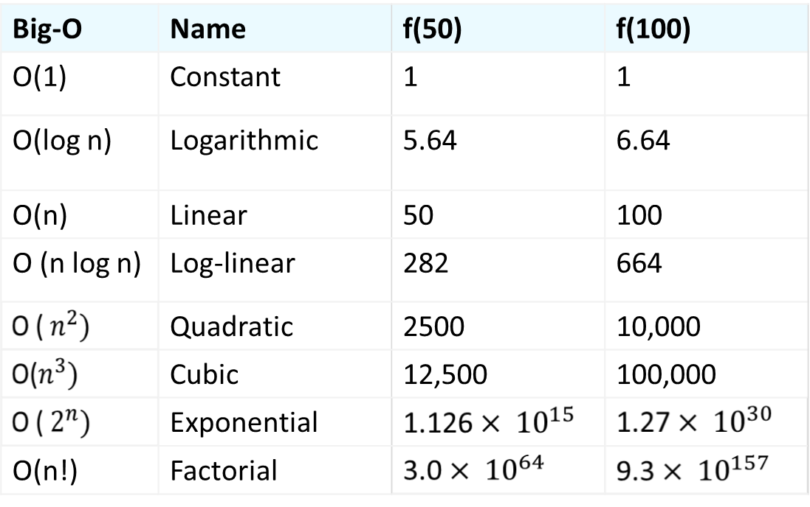
Comparing Performance (2)

